Slide 1
Trigonometry and
Modelling
Twitter: @Owen134866
www.mathsfreeresourcelibrary.com

Slide 2



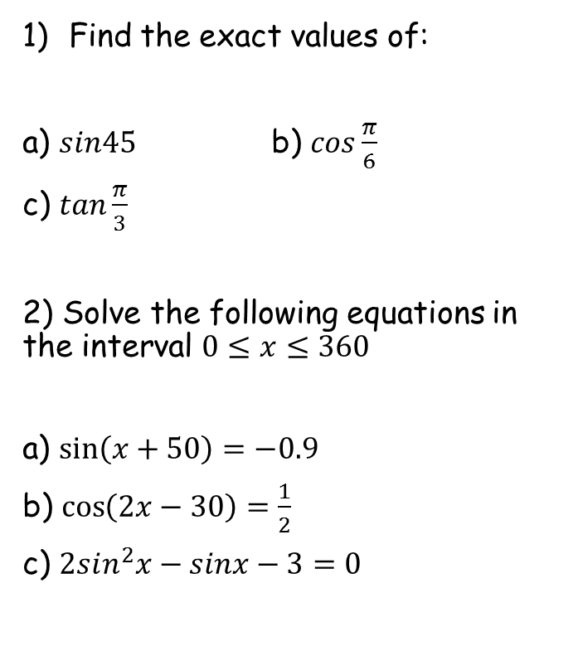




Prior Knowledge Check
Find the exact values of:
a) $sin45$ b) $cos\frac{π}{6}$
c) $tan\frac{π}{3}$
2) Solve the following equations in the interval $0≤x≤360$
a) $\sin\left(x+50\right)=−0.9$
b) $\cos\left(2x−30\right)=\frac{1}{2}$
c) $2sin^{2}x−sinx−3=0$
3) Prove the following:
a) $cosx+sinxtanx≡secx$
b) $cotxsecxsinx≡1$
c) $\frac{\cos^{2}x+\sin^{2}x}{1+\cot^{2}x}≡\sin^{2}x$
$\frac{1}{\sqrt{2}}$ or $\frac{\sqrt{2}}{2}$
$$\frac{\sqrt{3}}{2}$$
$$\sqrt{3}$$
$$194.2, 245.8$$
$$45, 165, 225, 345$$
$$270$$

Slide 3
Teachings for
Exercise 7A

Slide 4






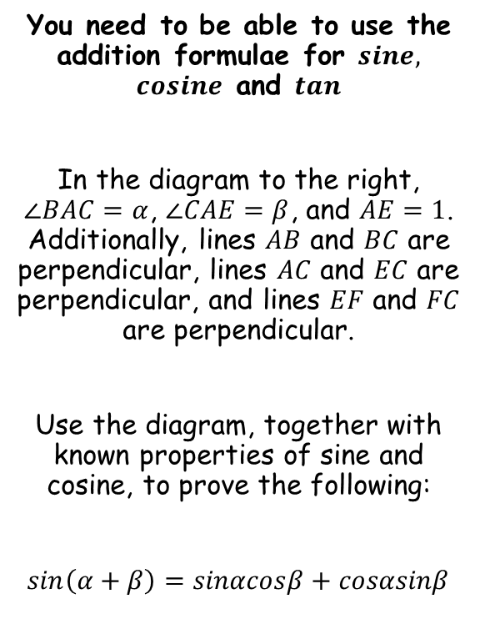









Trigonometry and Modelling
$$G$$
$$E$$
You need to be able to use the addition formulae for $sine,$ $cosine$ and $tan$
In the diagram to the right, $∠BAC=α$, $∠CAE=β$, and $AE=1$. Additionally, lines $AB$ and $BC$ are perpendicular, lines $AC$ and $EC$ are perpendicular, and lines $EF$ and $FC$ are perpendicular.
Use the diagram, together with known properties of sine and cosine, to prove the following:
$sin\left(α+β\right)=sinαcosβ+cosαsinβ$
$$α$$
$$1$$
$$90−α$$
$$F$$
$$α$$
$$C$$
$$β$$
$$α$$
$$A$$
$$D$$
$$B$$
→ Since $FC$ and $AB$ are parallel, $∠ACF=α$
→ This means that $∠ECF=90−α$
→ Which then means that $∠CEF=α$
7A

Slide 5




Trigonometry and Modelling
$$G$$
$$E$$
You need to be able to use the addition formulae for $sine,$ $cosine$ and $tan$
In the diagram to the right, $∠BAC=α$, $∠CAE=β$, and $AE=1$. Additionally, lines $AB$ and $BC$ are perpendicular, lines $AC$ and $EC$ are perpendicular, and lines $EF$ and $FC$ are perpendicular.
Use the diagram, together with known properties of sine and cosine, to prove the following:
$sin\left(α+β\right)=sinαcosβ+cosαsinβ$
$$α$$
$$sinβ$$
$$1$$
$$F$$
$$C$$
$$β$$
$$α$$
$$A$$
$$D$$
$$B$$
In a right-angled triangle: $Opp=Sinθ×Hyp$
→ In triangle $ACE$, the angle is $β$ and the Hypotenuse is 1
$$Opp=Sinβ×1$$
$$Opp=Sinβ$$
7A

Slide 6






Trigonometry and Modelling
$$G$$
$$E$$
You need to be able to use the addition formulae for $sine,$ $cosine$ and $tan$
In the diagram to the right, $∠BAC=α$, $∠CAE=β$, and $AE=1$. Additionally, lines $AB$ and $BC$ are perpendicular, lines $AC$ and $EC$ are perpendicular, and lines $EF$ and $FC$ are perpendicular.
Use the diagram, together with known properties of sine and cosine, to prove the following:
$sin\left(α+β\right)=sinαcosβ+cosαsinβ$
$$α$$
$$cosαsinβ$$
$$sinβ$$
$$1$$
$$F$$
$$C$$
$$β$$
$$α$$
$$A$$
$$D$$
$$B$$
In a right-angled triangle: $Adj=Cosθ×Hyp$
→ In triangle $FEC$, the angle is $α$ and the Hypotenuse is $sinβ$
$$Adj=Cosα×Sinβ$$
$$Adj=CosαSinβ$$
7A

Slide 7




Trigonometry and Modelling
$$G$$
$$E$$
You need to be able to use the addition formulae for $sine,$ $cosine$ and $tan$
In the diagram to the right, $∠BAC=α$, $∠CAE=β$, and $AE=1$. Additionally, lines $AB$ and $BC$ are perpendicular, lines $AC$ and $EC$ are perpendicular, and lines $EF$ and $FC$ are perpendicular.
Use the diagram, together with known properties of sine and cosine, to prove the following:
$sin\left(α+β\right)=sinαcosβ+cosαsinβ$
$$α$$
$$cosαsinβ$$
$$sinβ$$
$$1$$
$$sinαsinβ$$
$$F$$
$$C$$
$$β$$
$$α$$
$$A$$
$$D$$
$$B$$
In a right-angled triangle: $Opp=Sinθ×Hyp$
→ In triangle $FEC$, the angle is $α$ and the Hypotenuse is $sinβ$
$$Adj=Sinα×Sinβ$$
$$Adj=SinαSinβ$$
7A

Slide 8




Trigonometry and Modelling
$$G$$
$$E$$
You need to be able to use the addition formulae for $sine,$ $cosine$ and $tan$
In the diagram to the right, $∠BAC=α$, $∠CAE=β$, and $AE=1$. Additionally, lines $AB$ and $BC$ are perpendicular, lines $AC$ and $EC$ are perpendicular, and lines $EF$ and $FC$ are perpendicular.
Use the diagram, together with known properties of sine and cosine, to prove the following:
$sin\left(α+β\right)=sinαcosβ+cosαsinβ$
$$α$$
$$cosαsinβ$$
$$sinβ$$
$$1$$
$$sinαsinβ$$
$$F$$
$$C$$
$$cosβ$$
$$β$$
$$α$$
$$A$$
$$D$$
$$B$$
In a right-angled triangle: $Adj=Cosθ×Hyp$
→ In triangle $ACE$, the angle is $β$ and the Hypotenuse is 1
$$Adj=Cosβ×1$$
$$Adj=Cosβ$$
7A

Slide 9





Trigonometry and Modelling
$$G$$
$$E$$
You need to be able to use the addition formulae for $sine,$ $cosine$ and $tan$
In the diagram to the right, $∠BAC=α$, $∠CAE=β$, and $AE=1$. Additionally, lines $AB$ and $BC$ are perpendicular, lines $AC$ and $EC$ are perpendicular, and lines $EF$ and $FC$ are perpendicular.
Use the diagram, together with known properties of sine and cosine, to prove the following:
$sin\left(α+β\right)=sinαcosβ+cosαsinβ$
$$α$$
$$cosαsinβ$$
$$sinβ$$
$$1$$
$$sinαsinβ$$
$$F$$
$$C$$
$$cosβ$$
$$sinαcosβ$$
$$β$$
$$α$$
$$A$$
$$D$$
$$B$$
In a right-angled triangle: $Opp=Sinθ×Hyp$
→ In triangle $ACB$, the angle is $α$ and the Hypotenuse is $cosβ$
$$Opp=Sinα×Cosβ$$
$$Opp=SinαCosβ$$
7A

Slide 10






Trigonometry and Modelling
$$G$$
$$E$$
You need to be able to use the addition formulae for $sine,$ $cosine$ and $tan$
In the diagram to the right, $∠BAC=α$, $∠CAE=β$, and $AE=1$. Additionally, lines $AB$ and $BC$ are perpendicular, lines $AC$ and $EC$ are perpendicular, and lines $EF$ and $FC$ are perpendicular.
Use the diagram, together with known properties of sine and cosine, to prove the following:
$sin\left(α+β\right)=sinαcosβ+cosαsinβ$
$$α$$
$$cosαsinβ$$
$$sinβ$$
$$1$$
$$sinαsinβ$$
$$F$$
$$C$$
$$cosβ$$
$$sinαcosβ$$
$$β$$
$$α$$
$$A$$
$$D$$
$$B$$
$$cosαcosβ$$
In a right-angled triangle: $Adj=Cosθ×Hyp$
→ In triangle $ACB$, the angle is $α$ and the Hypotenuse is $cosβ$
$$Adj=Cosα×Cosβ$$
$$Adj=CosαCosβ$$
7A

Slide 11







Trigonometry and Modelling
$$G$$
$$E$$
You need to be able to use the addition formulae for $sine,$ $cosine$ and $tan$
In the diagram to the right, $∠BAC=α$, $∠CAE=β$, and $AE=1$. Additionally, lines $AB$ and $BC$ are perpendicular, lines $AC$ and $EC$ are perpendicular, and lines $EF$ and $FC$ are perpendicular.
Use the diagram, together with known properties of sine and cosine, to prove the following:
$sin\left(α+β\right)=sinαcosβ+cosαsinβ$
$$α$$
$$cosαsinβ$$
$$sinβ$$
$$1$$
$$sinαsinβ$$
$$F$$
$$C$$
$$cosβ$$
$$sinαcosβ$$
$$β$$
$$α$$
$$A$$
$$D$$
$$B$$
$$cosαcosβ$$
In a right-angled triangle: $Opp=Sinθ×Hyp$
→ In triangle $AED$, the angle is $(α+β)$ and the Hypotenuse is $1$
$$Opp=Sin(α+β)×1$$
$$Opp=Sin(α+β)$$
→ However, we also know that the Opposite side is $sinαcosβ+cosαsinβ$…
$$Opp=sinαcosβ+cosαsinβ$$
7A

Slide 12




Trigonometry and Modelling
$$sin\left(α+β\right)=sinαcosβ+cosαsinβ$$
$$G$$
$$E$$
You need to be able to use the addition formulae for $sine,$ $cosine$ and $tan$
In the diagram to the right, $∠BAC=α$, $∠CAE=β$, and $AE=1$. Additionally, lines $AB$ and $BC$ are perpendicular, lines $AC$ and $EC$ are perpendicular, and lines $EF$ and $FC$ are perpendicular.
Use the diagram, together with known properties of sine and cosine, to prove the following:
$sin\left(α+β\right)=sinαcosβ+cosαsinβ$
$$α$$
$$cosαsinβ$$
$$sinβ$$
$$1$$
$$sinαsinβ$$
$$F$$
$$C$$
$$cosβ$$
$$sinαcosβ$$
$$β$$
$$α$$
$$A$$
$$D$$
$$B$$
$$cosαcosβ$$
$$Opp=sin(α+β)$$
$$Opp=sinαcosβ+cosαsinβ$$
Therefore…
$$sin\left(α+β\right)=sinαcosβ+cosαsinβ$$
7A

Slide 13
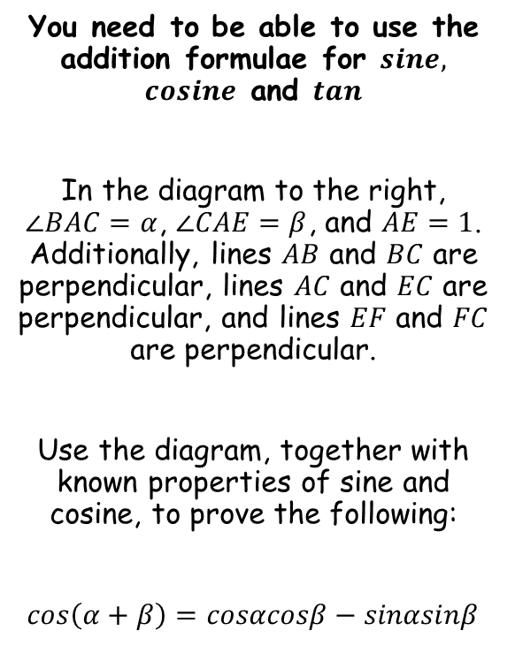





Trigonometry and Modelling
$$sin\left(α+β\right)=sinαcosβ+cosαsinβ$$
$$G$$
$$E$$
You need to be able to use the addition formulae for $sine,$ $cosine$ and $tan$
In the diagram to the right, $∠BAC=α$, $∠CAE=β$, and $AE=1$. Additionally, lines $AB$ and $BC$ are perpendicular, lines $AC$ and $EC$ are perpendicular, and lines $EF$ and $FC$ are perpendicular.
Use the diagram, together with known properties of sine and cosine, to prove the following:
$cos\left(α+β\right)=cosαcosβ−sinαsinβ$
$$α$$
$$cosαsinβ$$
$$sinβ$$
$$1$$
$$sinαsinβ$$
$$F$$
$$C$$
$$cosβ$$
$$sinαcosβ$$
$$β$$
$$α$$
$$A$$
$$D$$
$$B$$
$$cosαcosβ$$
In a right-angled triangle: $Adj=Cosθ×Hyp$
→ In triangle $AED$, the angle is $(α+β)$ and the Hypotenuse is $1$
$$Adj=Cos(α+β)×1$$
$$Adj=Cos(α+β)$$
→ However, we also know that the Adjacent side is $cosαcosβ−sinαsinβ$…
$$Adj=cosαcosβ−sinαsinβ$$
7A

Slide 14




Trigonometry and Modelling
$$sin\left(α+β\right)=sinαcosβ+cosαsinβ$$
$$cos\left(α+β\right)=cosαcosβ−sinαsinβ$$
$$G$$
$$E$$
You need to be able to use the addition formulae for $sine,$ $cosine$ and $tan$
In the diagram to the right, $∠BAC=α$, $∠CAE=β$, and $AE=1$. Additionally, lines $AB$ and $BC$ are perpendicular, lines $AC$ and $EC$ are perpendicular, and lines $EF$ and $FC$ are perpendicular.
Use the diagram, together with known properties of sine and cosine, to prove the following:
$cos\left(α+β\right)=cosαcosβ−sinαsinβ$
$$α$$
$$cosαsinβ$$
$$sinβ$$
$$1$$
$$sinαsinβ$$
$$F$$
$$C$$
$$cosβ$$
$$sinαcosβ$$
$$β$$
$$α$$
$$A$$
$$D$$
$$B$$
$$cosαcosβ$$
$$Adj=cos(α+β)$$
$$Adj=cosαcosβ−sinαsinβ$$
Therefore…
$$cos\left(α+β\right)=cosαcosβ−sinαsinβ$$
7A

Slide 15









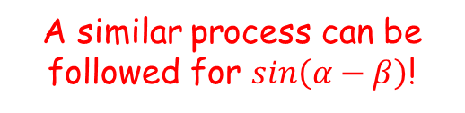






Trigonometry and Modelling
$$sin\left(α+β\right)=sinαcosβ+cosαsinβ$$
$$cos\left(α+β\right)=cosαcosβ−sinαsinβ$$
$$sin\left(α−β\right)=sinαcosβ−cosαsinβ$$
$$cos\left(α−β\right)=cosαcosβ+sinαsinβ$$
You need to be able to use the addition formulae for $sine,$ $cosine$ and $tan$
Use the results above to show that:
$$cos\left(A−B\right)=cosAcosB+sinAsinB$$
$$cos\left(α+β\right)=cosαcosβ−sinαsinβ$$
Replace $α$ and $β$ with $A$ and $B$
$$cos\left(A+B\right)=cosAcosB−sinAsinB$$
Replace $B$ with $(−B)$
$$cos\left(A+(−B)\right)=cosAcos(−B)−sinAsin(−B)$$
You can use some trig relationships
$$cos\left(A−B\right)=$$
$$cosAcosB$$
$$− sinA(−sinB)$$
Simplify
$$cos\left(A−B\right)=$$
$$cosAcosB$$
$$+ sinAsinB$$
$$cosθ=cos⁡(−θ)$$
For example
A similar process can be followed for $sin\left(α−β\right)$!
$$cos20=cos⁡(−20)$$
$$sinθ=−sinθ$$
For example
$$sin40=−sin40$$
7A

Slide 16




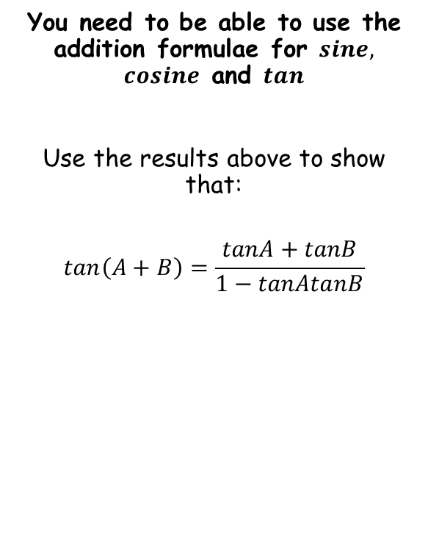


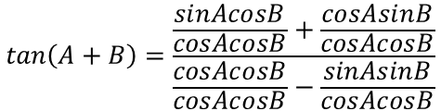
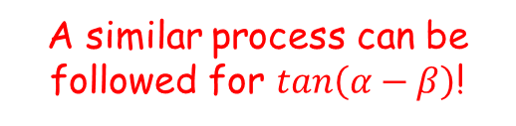
Trigonometry and Modelling
$$sin\left(α+β\right)=sinαcosβ+cosαsinβ$$
$$cos\left(α+β\right)=cosαcosβ−sinαsinβ$$
$$tan\left(A+B\right)=\frac{tanA+tanB}{1−tanAtanB}$$
$$sin\left(α−β\right)=sinαcosβ−cosαsinβ$$
$$cos\left(α−β\right)=cosαcosβ+sinαsinβ$$
$$tan\left(A−B\right)=\frac{tanA−tanB}{1+tanAtanB}$$
You need to be able to use the addition formulae for $sine,$ $cosine$ and $tan$
Use the results above to show that:
$$tan\left(A+B\right)=\frac{tanA+tanB}{1−tanAtanB}$$
$$tan\left(A+B\right)=\frac{sin\left(A+B\right)}{cos\left(A+B\right)}$$
Replace using the relationships above
$$tan\left(A+B\right)=\frac{sinAcosB+cosAsinB}{cosAcosB−sinAsinB}$$
Divide all terms by $cosAcosB$
$$tan\left(A+B\right)=\frac{\frac{sinAcosB}{cosAcosB}+\frac{cosAsinB}{cosAcosB}}{\frac{cosAcosB}{cosAcosB}−\frac{sinAsinB}{cosAcosB}}$$
Simplify each term
$$tan\left(A+B\right)=\frac{tanA+tanB}{1−tanAtanB}$$
A similar process can be followed for $tan\left(α−β\right)$!
7A

Slide 17





Trigonometry and Modelling
$$sin\left(α+β\right)=sinαcosβ+cosαsinβ$$
$$cos\left(α+β\right)=cosαcosβ−sinαsinβ$$
$$tan\left(A+B\right)=\frac{tanA+tanB}{1−tanAtanB}$$
$$sin\left(α−β\right)=sinαcosβ−cosαsinβ$$
$$cos\left(α−β\right)=cosαcosβ+sinαsinβ$$
$$tan\left(A−B\right)=\frac{tanA−tanB}{1+tanAtanB}$$
You need to be able to use the addition formulae for $sine,$ $cosine$ and $tan$
Prove that:
$$\frac{cosA}{sinB}−\frac{sinA}{cosB}≡\frac{cos\left(A+B\right)}{sinBcosB}$$
$$\frac{cosA}{sinB}−\frac{sinA}{cosB}$$
Multiply to make the denominators equal
$$=\frac{cosAcosB}{sinBcosB}−\frac{sinAsinB}{cosBsinB}$$
Group together
$$=\frac{cosAcosB−sinAsinB}{sinBcosB}$$
The top can be replaced using one of the identities above
$$=\frac{cos⁡(A+B)}{sinBcosB}$$
7A

Slide 18



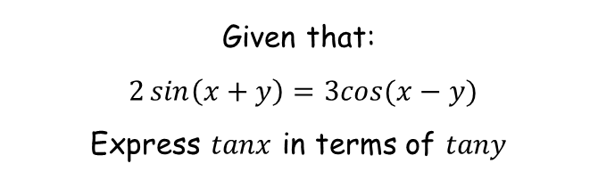

















Trigonometry and Modelling
$$sin\left(α+β\right)=sinαcosβ+cosαsinβ$$
$$cos\left(α+β\right)=cosαcosβ−sinαsinβ$$
$$tan\left(A+B\right)=\frac{tanA+tanB}{1−tanAtanB}$$
$$sin\left(α−β\right)=sinαcosβ−cosαsinβ$$
$$cos\left(α−β\right)=cosαcosβ+sinαsinβ$$
$$tan\left(A−B\right)=\frac{tanA−tanB}{1+tanAtanB}$$
Given that:
$2\sin\left(x+y\right)=3cos⁡(x−y)$
Express $tanx$ in terms of $tany$
$$2\sin\left(x+y\right)=3cos⁡(x−y)$$
Rewrite the sin and cos parts
$$2{(sinxcosy+cosxsiny)}$$
$$= 3{(cosxcosy+sinxsiny)}$$
Multiply out the brackets
$$2{sinxcosy+2cosxsiny}$$
$$= 3{cosxcosy+3sinxsiny}$$
Divide all by cosxcosy
$$2{sinxcosy+2cosxsiny}$$
$$= 3{cosxcosy+3sinxsiny}$$
$$cosxcosy$$
$$cosxcosy$$
$$cosxcosy$$
$$cosxcosy$$
Simplify
$$2{tanx+2tany}$$
$$= 3{+3tanxtany}$$
Subtract 3tanxtany
Subtract 2tany
$$2{tanx−3tanxtany}$$
$$= 3{−2tany}$$
Factorise the left side
$$tanx(2−3tany)$$
$$= 3{−2tany}$$
$$tanx$$
$$= 3{−2tany}$$
Divide by (2 – 3tany)
$$2{−3tany}$$
7A

Slide 19
Teachings for
Exercise 7B

Slide 20











Trigonometry and Modelling
$$sin\left(α+β\right)=sinαcosβ+cosαsinβ$$
$$cos\left(α+β\right)=cosαcosβ−sinαsinβ$$
$$tan\left(A+B\right)=\frac{tanA+tanB}{1−tanAtanB}$$
$$sin\left(α−β\right)=sinαcosβ−cosαsinβ$$
$$cos\left(α−β\right)=cosαcosβ+sinαsinβ$$
$$tan\left(A−B\right)=\frac{tanA−tanB}{1+tanAtanB}$$
You need to be able to use the addition formulae
Show, using the formula for Sin(A – B), that:
Think about how you could write 15˚ using angles that can be expressed exactly…
Sin(A - B) ≡ SinACosB - CosASinB
A=45, B=30
$$Sin15=\frac{\sqrt{6}−\sqrt{2}}{4}$$
Sin(45 - 30) ≡ Sin45Cos30 – Cos45Sin30
These can be written as surds
Sin(45 - 30) ≡
$$\frac{\sqrt{2}}{2}$$
$$\frac{\sqrt{3}}{2}$$
$$\frac{\sqrt{2}}{2}$$
$$\frac{1}{2}$$
$$×$$
$$−$$
$$×$$
Multiply each pair
Sin(45 - 30) ≡
$$\frac{\sqrt{6}}{4}$$
$$\frac{\sqrt{2}}{4}$$
$$−$$
$$Sin15=Sin(45−30)$$
Group the fractions up
$$\frac{\sqrt{6}−\sqrt{2}}{4}$$
Sin(15) ≡
7B

Slide 21












Trigonometry and Modelling
$$sin\left(α+β\right)=sinαcosβ+cosαsinβ$$
$$cos\left(α+β\right)=cosαcosβ−sinαsinβ$$
$$tan\left(A+B\right)=\frac{tanA+tanB}{1−tanAtanB}$$
$$sin\left(α−β\right)=sinαcosβ−cosαsinβ$$
$$cos\left(α−β\right)=cosαcosβ+sinαsinβ$$
$$tan\left(A−B\right)=\frac{tanA−tanB}{1+tanAtanB}$$
You need to be able to use the addition formulae
Given that:
Find the value of:
$$SinA=\frac{Opp}{Hyp}$$
$$TanA=\frac{Opp}{Adj}$$
5
$$SinA=−\frac{3}{5}$$
3
$$TanA=\frac{3}{4}$$
$SinA=−\frac{3}{5} 180˚$ < A < 270˚
A
4
Cos$B=−\frac{12}{13} B=Obtuse$
Use Pythagoras’ to find the missing side (ignore negatives)
Tan is positive in the range 180˚ - 270˚
Tan(A+B)
$$TanB=\frac{Opp}{Adj}$$
$$CosB=\frac{Adj}{Hyp}$$
13
5
Tan (A + B) $≡\frac{TanA+TanB}{1−TanATanB}$
B
$$TanB=\frac{5}{12}$$
$$CosB=−\frac{12}{13}$$
12
$$TanB=−\frac{5}{12}$$
y = Tanθ
Use Pythagoras’ to find the missing side (ignore negatives)
90
180
270
360
Tan is negative in the range 90˚ - 180˚
7B

Slide 22


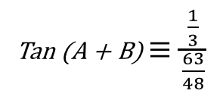
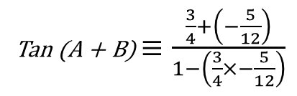



Trigonometry and Modelling
$$sin\left(α+β\right)=sinαcosβ+cosαsinβ$$
$$cos\left(α+β\right)=cosαcosβ−sinαsinβ$$
$$tan\left(A+B\right)=\frac{tanA+tanB}{1−tanAtanB}$$
$$sin\left(α−β\right)=sinαcosβ−cosαsinβ$$
$$cos\left(α−β\right)=cosαcosβ+sinαsinβ$$
$$tan\left(A−B\right)=\frac{tanA−tanB}{1+tanAtanB}$$
You need to be able to use the addition formulae
Given that:
Find the value of:
Tan (A + B) $≡\frac{TanA+TanB}{1−TanATanB}$
Substitute in TanA and TanB
$SinA=−\frac{3}{5} 180˚$ < A < 270˚
Tan (A + B) $≡\frac{\frac{3}{4}+\left(−\frac{5}{12}\right)}{1−\left(\frac{3}{4}×−\frac{5}{12}\right)}$
Cos$B=−\frac{12}{13} B=Obtuse$
Work out the Numerator and Denominator
Tan (A + B) $≡\frac{\frac{1}{3}}{\frac{63}{48}}$
Tan(A+B)
Leave, Change and Flip
Tan (A + B) $≡\frac{TanA+TanB}{1−TanATanB}$
Tan (A + B) $≡\frac{1}{3}×\frac{48}{63}$
$$TanA=\frac{3}{4}$$
$$TanB=−\frac{5}{12}$$
Simplify
Tan (A + B) $≡\frac{16}{63}$
Although you could just type the whole thing into your calculator, you still need to show the stages for the workings marks…
7B

Slide 23
Teachings for
Exercise 7C

Slide 24


Trigonometry and Modelling
$$Sin2A≡2sinAcosA$$
You can express sin2A, cos2A and tan2A in terms of angle A, using the double angle formulae
Sin(A + B) ≡ SinACosB + CosASinB
Replace B with A
Sin(A + A) ≡ SinACosA + CosASinA
Simplify
Sin2A ≡ 2SinACosA
$\frac{1}{2}$Sin2A ≡ SinACosA
Sin4A ≡ 2Sin2ACos2A
÷ 2
2A → 4A
Sin2A ≡ 2SinACosA
x 3
2A = 60
3Sin2A ≡ 6SinACosA
Sin60 ≡ 2Sin30Cos30
7C

Slide 25









Trigonometry and Modelling
$$Sin2A≡2sinAcosA$$
$$Cos2A≡{Cos}^{2}A−{Sin}^{2}A$$
$$Cos2A≡1−2{Sin}^{2}A$$
$$Cos2A≡2{Cos}^{2}A−1$$
You can express sin2A, cos2A and tan2A in terms of angle A, using the double angle formulae
Cos(A + B) ≡ CosACosB - SinASinB
Replace B with A
Cos(A + A) ≡ CosACosA - SinASinA
Simplify
Cos2A ≡ Co$s^{2}A −Sin^{2}A$
Cos2A ≡ Co$s^{2}A −Sin^{2}A$
Replace Cos²A with (1 – Sin²A)
Replace Sin²A with (1 – Cos²A)
Cos2A ≡ (1$−Sin^{2}A)−Sin^{2}A$
Cos2A ≡ Co$s^{2}A −($1 - Co$s^{2}A)$
Cos2A ≡ 1$− 2Sin^{2}A$
Cos2A ≡ 2Co$s^{2}A −1$
7C

Slide 26







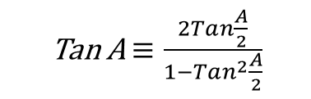

Trigonometry and Modelling
$$Sin2A≡2sinAcosA$$
$$Cos2A≡{Cos}^{2}A−{Sin}^{2}A$$
$$Cos2A≡1−2{Sin}^{2}A$$
$$Cos2A≡2{Cos}^{2}A−1$$
$$Tan2A≡\frac{2TanA}{1−{Tan}^{2}A}$$
You can express sin2A, cos2A and tan2A in terms of angle A, using the double angle formulae
Tan (A + B) $≡\frac{TanA+TanB}{1−TanATanB}$
Replace B with A
Tan (A + A) $≡\frac{TanA+TanA}{1−TanATanA}$
Simplify
Tan 2A $≡\frac{2TanA}{1−Tan^{2}A}$
$\frac{1}{2}$Tan 2A $≡\frac{TanA}{1−Tan^{2}A}$
Tan 60 $≡\frac{2Tan30}{1−Tan^{2}30}$
÷ 2
2A = 60
Tan 2A $≡\frac{2TanA}{1−Tan^{2}A}$
x 2
2A = A
Tan A $≡\frac{2Tan\frac{A}{2}}{1−Tan^{2}\frac{A}{2}}$
2Tan 2A $≡\frac{4TanA}{1−Tan^{2}A}$
7C

Slide 27

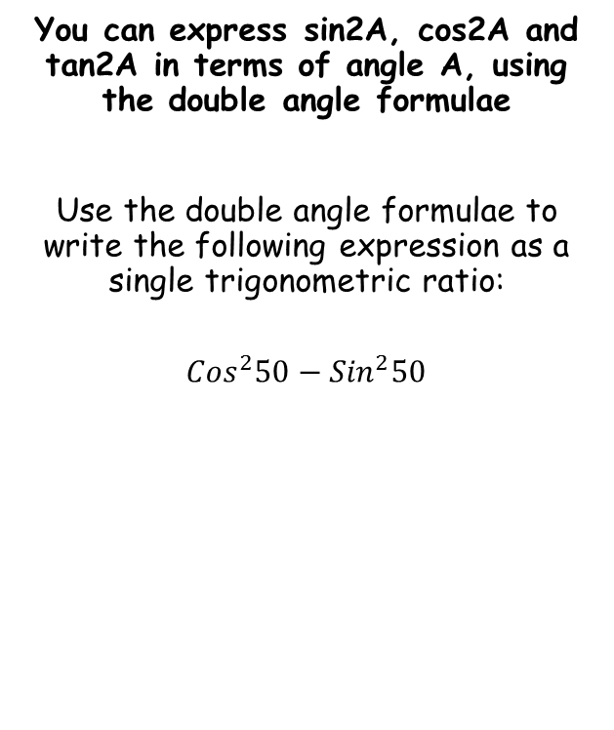
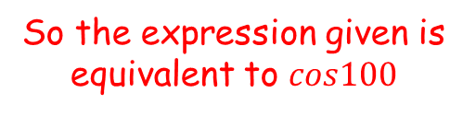


Trigonometry and Modelling
$$Sin2A≡2sinAcosA$$
$$Cos2A≡{Cos}^{2}A−{Sin}^{2}A$$
$$Cos2A≡1−2{Sin}^{2}A$$
$$Cos2A≡2{Cos}^{2}A−1$$
$$Tan2A≡\frac{2TanA}{1−{Tan}^{2}A}$$
You can express sin2A, cos2A and tan2A in terms of angle A, using the double angle formulae
Use the double angle formulae to write the following expression as a single trigonometric ratio:
$${Cos}^{2}50−{Sin}^{2}50$$
$$Cos2A≡{Cos}^{2}A−{Sin}^{2}A$$
Let $A=50$
$$Cos100≡{Cos}^{2}50−{Sin}^{2}50$$
So the expression given is equivalent to $cos100$
7C

Slide 28

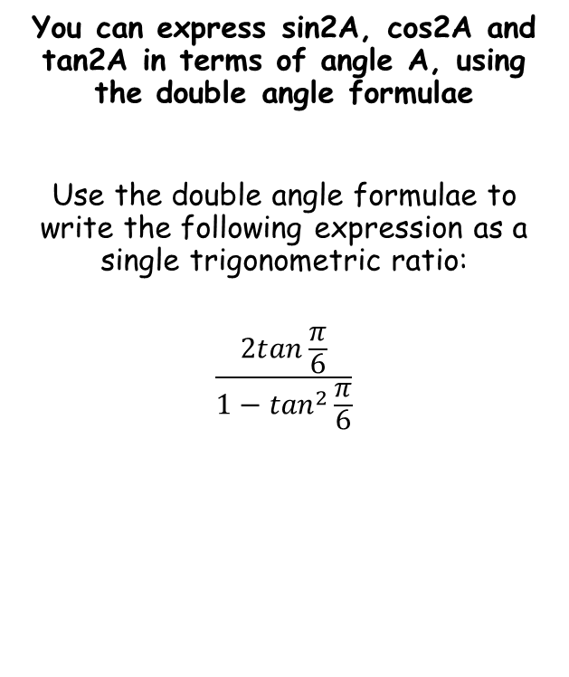
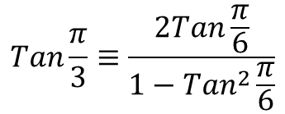
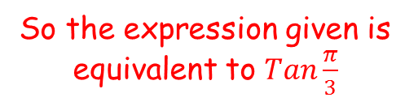

Trigonometry and Modelling
$$Sin2A≡2sinAcosA$$
$$Cos2A≡{Cos}^{2}A−{Sin}^{2}A$$
$$Cos2A≡1−2{Sin}^{2}A$$
$$Cos2A≡2{Cos}^{2}A−1$$
$$Tan2A≡\frac{2TanA}{1−{Tan}^{2}A}$$
You can express sin2A, cos2A and tan2A in terms of angle A, using the double angle formulae
Use the double angle formulae to write the following expression as a single trigonometric ratio:
$$\frac{2tan\frac{π}{6}}{1−\tan^{2}\frac{π}{6}}$$
$$Tan2A≡\frac{2TanA}{1−{Tan}^{2}A}$$
Let $A=\frac{π}{6}$
$$Tan\frac{π}{3}≡\frac{2Tan\frac{π}{6}}{1−{Tan}^{2}\frac{π}{6}}$$
So the expression given is equivalent to $Tan\frac{π}{3}$
7C

Slide 29



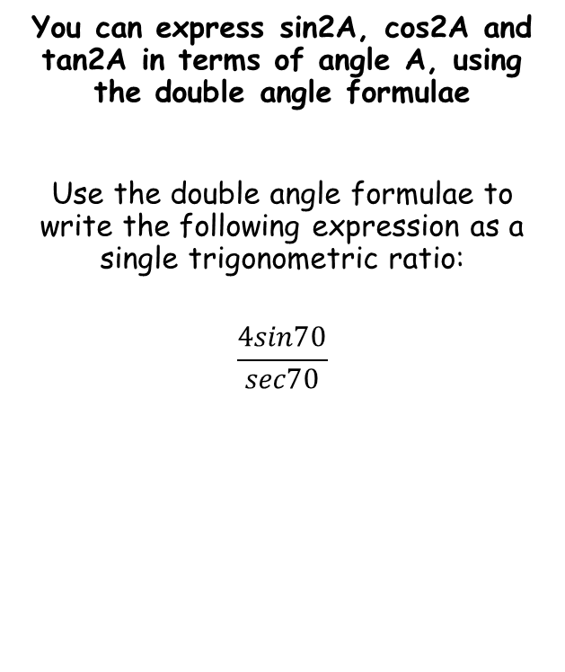



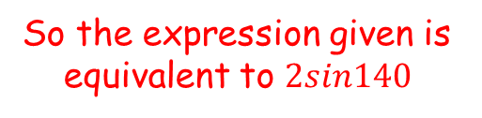
Trigonometry and Modelling
$$Sin2A≡2sinAcosA$$
$$Cos2A≡{Cos}^{2}A−{Sin}^{2}A$$
$$Cos2A≡1−2{Sin}^{2}A$$
$$Cos2A≡2{Cos}^{2}A−1$$
$$Tan2A≡\frac{2TanA}{1−{Tan}^{2}A}$$
You can express sin2A, cos2A and tan2A in terms of angle A, using the double angle formulae
Use the double angle formulae to write the following expression as a single trigonometric ratio:
$$\frac{4sin70}{sec70}$$
$$\frac{4sin70}{sec70}$$
Rearrange
$$=4sin70cos70$$
$$Sin2A≡2sinAcosA$$
Let $A=70$
$$Sin140≡2sin70cos70$$
Multiply by 2
$$2Sin140≡4sin70cos70$$
So the expression given is equivalent to $2sin140$
7C

Slide 30
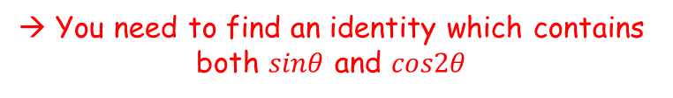













Trigonometry and Modelling
$$Sin2A≡2sinAcosA$$
$$Cos2A≡{Cos}^{2}A−{Sin}^{2}A$$
$$Cos2A≡1−2{Sin}^{2}A$$
$$Cos2A≡2{Cos}^{2}A−1$$
$$Tan2A≡\frac{2TanA}{1−{Tan}^{2}A}$$
→ You need to find an identity which contains both $sinθ$ and $cos2θ$
You can express sin2A, cos2A and tan2A in terms of angle A, using the double angle formulae
Given that $x=3sinθ$ and
$y=3−4cos2θ$, eliminate $θ$ and express $y$ in terms of $x$.
$$Cos2A≡1−2{Sin}^{2}A$$
Replace with $θ$ (this step is not really needed!)
$$Cos2θ≡1−2{Sin}^{2}θ$$
Replace using the expressions we have
$$\frac{3−y}{4}=1−2{\left(\frac{x}{3}\right)}^{2}$$
→ Write expressions for $sinθ$ and $cos2θ$
Multiply by 4
$$3−y=4−8{\left(\frac{x}{3}\right)}^{2}$$
$$x=3sinθ$$
$$y=3−4cos2θ$$
Subtract 3
$$−y=1−8{\left(\frac{x}{3}\right)}^{2}$$
→ Rearrange both
Multiply all by -1
$$sinθ=\frac{x}{3}$$
$$cos2θ=\frac{3−y}{4}$$
$$y=8{\left(\frac{x}{3}\right)}^{2}−1$$
7C

Slide 31











Trigonometry and Modelling
$$Sin2A≡2sinAcosA$$
$$Cos2A≡{Cos}^{2}A−{Sin}^{2}A$$
$$Cos2A≡1−2{Sin}^{2}A$$
$$Cos2A≡2{Cos}^{2}A−1$$
$$Tan2A≡\frac{2TanA}{1−{Tan}^{2}A}$$
You can express sin2A, cos2A and tan2A in terms of angle A, using the double angle formulae
Given that:
Find the exact value of:
$$Cosx=\frac{Adj}{Hyp}$$
4
$$Sinx=\frac{Opp}{Hyp}$$
$$Cosx=\frac{3}{4}$$
$$\sqrt{7}$$
x
$$Sinx=\frac{\sqrt{7}}{4}$$
$$cosx=\frac{3}{4}$$
3
$$180˚<x<360˚$$
Use Pythagoras’ to find the missing side (ignore negatives)
Cosx is positive so in the range 270 - 360
$$sin2x$$
$$Sinx=−\frac{\sqrt{7}}{4}$$
Therefore, Sinx is negative
y = Cosθ
90
180
270
360
Sin2x ≡ 2SinxCosx
Sin2x = 2$×\frac{3}{4}×−\frac{\sqrt{7}}{4}$
Sub in Sinx and Cosx
y = Sinθ
Work out and leave in surd form
Sin2x = $−\frac{3\sqrt{7}}{8}$
7C

Slide 32



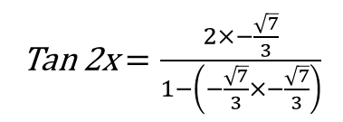



Trigonometry and Modelling
$$Sin2A≡2sinAcosA$$
$$Cos2A≡{Cos}^{2}A−{Sin}^{2}A$$
$$Cos2A≡1−2{Sin}^{2}A$$
$$Cos2A≡2{Cos}^{2}A−1$$
$$Tan2A≡\frac{2TanA}{1−{Tan}^{2}A}$$
You can express sin2A, cos2A and tan2A in terms of angle A, using the double angle formulae
Given that:
Find the exact value of:
$$Cosx=\frac{Adj}{Hyp}$$
4
$$Tanx=\frac{Opp}{Adj}$$
$$Cosx=\frac{3}{4}$$
$$\sqrt{7}$$
x
$$Tanx=\frac{\sqrt{7}}{3}$$
$$cosx=\frac{3}{4}$$
3
$$180˚<x<360˚$$
Use Pythagoras’ to find the missing side (ignore negatives)
Cosx is positive so in the range 270 - 360
$$tan2x$$
$$Tanx=−\frac{\sqrt{7}}{3}$$
Therefore, Tanx is negative
y = Cosθ
Tan 2x $≡\frac{2Tanx}{1−Tan^{2}x}$
90
180
270
360
Tan 2x $=\frac{2×−\frac{\sqrt{7}}{3}}{1−\left(−\frac{\sqrt{7}}{3}×−\frac{\sqrt{7}}{3}\right)}$
Sub in Tanx
y = Tanθ
Work out and leave in surd form
90
180
270
360
$$Tan2x=−3\sqrt{7}$$
7C

Slide 33
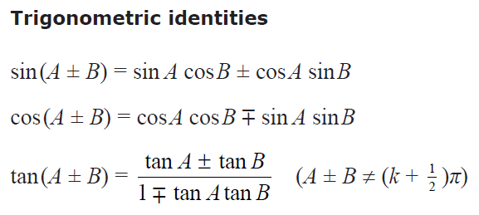
Trigonometry and Modelling
$$Sin2A≡2sinAcosA$$
$$Cos2A≡{Cos}^{2}A−{Sin}^{2}A$$
$$Cos2A≡1−2{Sin}^{2}A$$
$$Cos2A≡2{Cos}^{2}A−1$$
$$Tan2A≡\frac{2TanA}{1−{Tan}^{2}A}$$
You can express sin2A, cos2A and tan2A in terms of angle A, using the double angle formulae
You are given the addition formulae in the formula booklet, but you do not get the double angle formulae…
7C

Slide 34
Teachings for
Exercise 7D

Slide 35














Trigonometry and Modelling
$$sin\left(α+β\right)=sinαcosβ+cosαsinβ$$
$$cos\left(α+β\right)=cosαcosβ−sinαsinβ$$
$$tan\left(A+B\right)=\frac{tanA+tanB}{1−tanAtanB}$$
$$sin\left(α−β\right)=sinαcosβ−cosαsinβ$$
$$cos\left(α−β\right)=cosαcosβ+sinαsinβ$$
$$tan\left(A−B\right)=\frac{tanA−tanB}{1+tanAtanB}$$
You need to be able to use the angle relationships you have seen in equation solving
Solve $4cos\left(θ−30\right)=8\sqrt{2}sinθ$ in the range $0≤θ≤360$. Give answers to 1dp.
$$4cos\left(θ−30\right)=8\sqrt{2}sinθ$$
Use the expansion for $cos\left(α−β\right)$
$$4cosθcos30+4sinθsin30=8\sqrt{2}sinθ$$
Replace exact values where possible
$$4cosθ\left(\frac{\sqrt{3}}{2}\right)+4sinθ\left(\frac{1}{2}\right)=8\sqrt{2}sinθ$$
Simplify left side
$$2\sqrt{3}cosθ+2sinθ=8\sqrt{2}sinθ$$
Divide by 2
$$\sqrt{3}cosθ+sinθ=4\sqrt{2}sinθ$$
Subtract $sinθ$
$$\sqrt{3}cosθ=4\sqrt{2}sinθ−sinθ$$
Factorise right side
$$\sqrt{3}cosθ=sinθ\left(4\sqrt{2}−1\right)$$
Divide by the bracket
$$\frac{\sqrt{3}cosθ}{\left(4\sqrt{2}−1\right)}=sinθ$$
Divide by $cosθ$
$$\frac{\sqrt{3}}{\left(4\sqrt{2}−1\right)}=\frac{sinθ}{cosθ}$$
The right side equals $tanθ$
$$\frac{\sqrt{3}}{\left(4\sqrt{2}−1\right)}=tanθ$$
7D

Slide 36



Trigonometry and Modelling
$$sin\left(α+β\right)=sinαcosβ+cosαsinβ$$
$$cos\left(α+β\right)=cosαcosβ−sinαsinβ$$
$$tan\left(A+B\right)=\frac{tanA+tanB}{1−tanAtanB}$$
$$sin\left(α−β\right)=sinαcosβ−cosαsinβ$$
$$cos\left(α−β\right)=cosαcosβ+sinαsinβ$$
$$tan\left(A−B\right)=\frac{tanA−tanB}{1+tanAtanB}$$
You need to be able to use the angle relationships you have seen in equation solving
Solve $4cos\left(θ−30\right)=8\sqrt{2}sinθ$ in the range $0≤θ≤360$. Give answers to 1dp.
$$tanθ=\frac{\sqrt{3}}{\left(4\sqrt{2}−1\right)}$$
Inverse tan, and then find any alternative solutions…
$$tanθ=20.4^{°}$$
$$, 200.4^{°}$$
7D

Slide 37















Trigonometry and Modelling
$$Sin2A≡2sinAcosA$$
$$Cos2A≡{Cos}^{2}A−{Sin}^{2}A$$
$$Cos2A≡1−2{Sin}^{2}A$$
$$Cos2A≡2{Cos}^{2}A−1$$
$$Tan2A≡\frac{2TanA}{1−{Tan}^{2}A}$$
You need to be able to use the angle relationships you have seen in equation solving
Solve $3cos2x−cosx+2=0$ in the range $0≤x≤360$. Give answers to 1dp where appropriate.
$$3cos2x−cosx+2=0$$
Replace using one of the expressions above
$$3(2\cos^{2}x−1)−cosx+2=0$$
Expand bracket
$$6\cos^{2}x−3−cosx+2=0$$
Simplify
$$6\cos^{2}x−cosx−1=0$$
Factorise
$$\left(3cosx+1\right)\left(2cosx−1\right)=0$$
Write the 2 possible values for $cosx$
$$cosx=−\frac{1}{3}$$
$$cosx=\frac{1}{2}$$
Find the principle value, and then check for any others in the range (remember that $cosθ=cos⁡(360−θ)$
$$x=109.5$$
$$x=60$$
$$, 250.5$$
$$, 300$$
7D

Slide 38








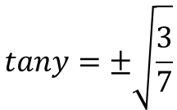
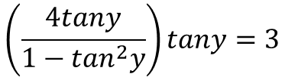
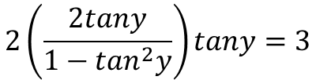

Trigonometry and Modelling
$$Sin2A≡2sinAcosA$$
$$Cos2A≡{Cos}^{2}A−{Sin}^{2}A$$
$$Cos2A≡1−2{Sin}^{2}A$$
$$Cos2A≡2{Cos}^{2}A−1$$
$$Tan2A≡\frac{2TanA}{1−{Tan}^{2}A}$$
You need to be able to use the angle relationships you have seen in equation solving
Solve $2tan2ytany=3$ in the range $0≤y≤2π$. Give answers to 2dp.
$$2tan2ytany=3$$
Replace using a relationship from above
$$2\left(\frac{2tany}{1−\tan^{2}y}\right)tany=3$$
Multiply the bracket by 2
$$\left(\frac{4tany}{1−\tan^{2}y}\right)tany=3$$
Multiply the bracket by $tany$
$$\frac{4tan^{2}y}{1−\tan^{2}y}=3$$
Multiply both sides by $1−\tan^{2}y$
$$4tan^{2}y=3−3\tan^{2}y$$
Add ${3tan}^{2}y$
$$7tan^{2}y=3$$
Divide by 7
$$tan^{2}y=\frac{3}{7}$$
$$tany=±\sqrt{\frac{3}{7}}$$
Square root
7D

Slide 39
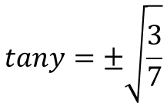




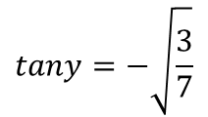
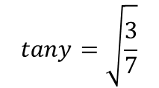

Trigonometry and Modelling
$$Sin2A≡2sinAcosA$$
$$Cos2A≡{Cos}^{2}A−{Sin}^{2}A$$
$$Cos2A≡1−2{Sin}^{2}A$$
$$Cos2A≡2{Cos}^{2}A−1$$
$$Tan2A≡\frac{2TanA}{1−{Tan}^{2}A}$$
You need to be able to use the angle relationships you have seen in equation solving
Solve $2tan2ytany=3$ in the range $0≤y≤2π$. Give answers to 2dp.
$$tany=±\sqrt{\frac{3}{7}}$$
Write the 2 possible values for $tany$
$$tany=\sqrt{\frac{3}{7}}$$
$$tany=−\sqrt{\frac{3}{7}}$$
Find the principle value, and then check for any others in the range (remember that $tanθ=tan⁡(θ+180)$)
$$y=0.58$$
$$, 3.72$$
$$y=2.56$$
$$, 5.70$$
7D

Slide 40
















Trigonometry and Modelling
$$Sin2A≡2sinAcosA$$
$$Cos2A≡{Cos}^{2}A−{Sin}^{2}A$$
$$Cos2A≡1−2{Sin}^{2}A$$
$$Cos2A≡2{Cos}^{2}A−1$$
$$Tan2A≡\frac{2TanA}{1−{Tan}^{2}A}$$
You need to be able to use the angle relationships you have seen in equation solving
a) By expanding $sin⁡(2A+A)$, show that:
$$sin3A≡3sinA−{4sin}^{3}A$$
$$sin\left(A+B\right)≡sinAcosB+cosAsinB$$
Replace A and B
$$sin\left(2A+A\right)≡sin2AcosA+cos2AsinA$$
$$sin\left(3A\right)≡$$
$$(2sinAcosA)cosA$$
$$+ (1−2sin^{2}A)sinA$$
$$sin\left(3A\right)≡$$
$$2sinAcos^{2}A$$
$$+ sinA−2sin^{3}A$$
Replace cos²A
$$sin\left(3A\right)≡$$
$$2sinA(1−\sin^{2}A)$$
$$+ sinA−2sin^{3}A$$
Multiply out
$$sin\left(3A\right)≡$$
$$2sinA−{2sin}^{3}A$$
$$+ sinA−2sin^{3}A$$
Group like terms
$$sin\left(3A\right)≡$$
$$3sinA−{4sin}^{3}A$$
7D

Slide 41




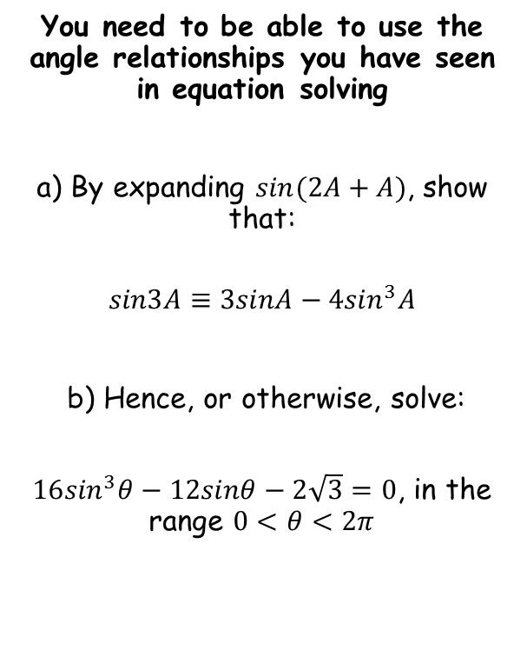






Trigonometry and Modelling
$$Sin2A≡2sinAcosA$$
$$Cos2A≡{Cos}^{2}A−{Sin}^{2}A$$
$$Cos2A≡1−2{Sin}^{2}A$$
$$Cos2A≡2{Cos}^{2}A−1$$
$$Tan2A≡\frac{2TanA}{1−{Tan}^{2}A}$$
You need to be able to use the angle relationships you have seen in equation solving
a) By expanding $sin⁡(2A+A)$, show that:
$$sin3A≡3sinA−{4sin}^{3}A$$
b) Hence, or otherwise, solve:
$16\sin^{3}θ−12sinθ−2\sqrt{3}=0$, in the range $0<θ<2π$
$$sin3A≡3sinA−{4sin}^{3}A$$
Replace $A$ with $θ$ if this helps!
$$sin3θ≡3sinθ−{4sin}^{3}θ$$
Multiply all by 4
$$4sin3θ≡12sinθ−{16sin}^{3}θ$$
Multiply by -1
$$−4sin3θ≡{16sin}^{3}θ−12sinθ$$
Subtract $2\sqrt{3}$
$$−4sin3θ−2\sqrt{3}≡{16sin}^{3}θ−12sinθ−2\sqrt{3}$$
If the right side equals 0, the left side must also equal 0…
$$−4sin3θ−2\sqrt{3}=0$$
Multiply by -1
$$4sin3θ+2\sqrt{3}=0$$
Subtract $2\sqrt{3}$
$$4sin3θ=−2\sqrt{3}$$
→ Try to find a way to change the relationship from a) into the equation you are solving…
$$sin3θ=−\frac{\sqrt{3}}{2}$$
Divide by 4
7D

Slide 42
























Trigonometry and Modelling
$$Sin2A≡2sinAcosA$$
$$Cos2A≡{Cos}^{2}A−{Sin}^{2}A$$
$$Cos2A≡1−2{Sin}^{2}A$$
$$Cos2A≡2{Cos}^{2}A−1$$
$$Tan2A≡\frac{2TanA}{1−{Tan}^{2}A}$$
You need to be able to use the angle relationships you have seen in equation solving
a) By expanding $sin⁡(2A+A)$, show that:
$$sin3A≡3sinA−{4sin}^{3}A$$
b) Hence, or otherwise, solve:
$16\sin^{3}θ−12sinθ−2\sqrt{3}=0$, in the range $0<θ<2π$
$$sin3θ=−\frac{\sqrt{3}}{2}$$
Inverse sine
$$3θ=−\frac{1}{3}π$$
Remember that $sinθ=sin\left(π−θ\right)$, so subtract this answer from $π$
$$3θ=\frac{4}{3}π$$
1
$$\frac{4π}{3}$$
$$\frac{3π}{2}$$
$$\frac{5π}{3}$$
$$2π$$
y = Sinθ
$$−\frac{\sqrt{3}}{2}$$
-1
$$\frac{π}{2}$$
$$π$$
Find other values in the initial range, then keep adding $2π$ to them to find more
$$3θ=\frac{4}{3}π$$
$$, \frac{5}{3}π$$
$$, \frac{10}{3}π$$
$$, \frac{11}{3}π$$
$$, \frac{16}{3}π$$
$$, \frac{17}{3}π$$
→ Adjust the range for the equation we are solving…
Divide all by 3
$$θ=\frac{4}{9}π$$
$$, \frac{5}{9}π$$
$$, \frac{10}{9}π$$
$$, \frac{11}{9}π$$
$$, \frac{16}{9}π$$
$$, \frac{17}{9}π$$
$$0<3θ<6π$$
7D

Slide 43
Teachings for
Exercise 7E

Slide 44


























Trigonometry and Modelling
$$Rsin(x+α)$$
$$=Rsinxcosα$$
$$+ Rcosxsinα$$
You can write expressions of the form acosθ + bsinθ, where a and b are constants, as a sine or cosine function only
Show that:
Can be expressed in the form:
So:
Replace with the expression
$$3sinx+4cosx$$
$$=Rsinxcosα$$
$$+ Rcosxsinα$$
Compare each term – they must be equal!
$$Rcosα=3$$
$$Rsinα=4$$
$$R$$
$$cosα=\frac{3}{R}$$
$$\left(\frac{A}{H}\right)$$
$$sinα=\frac{4}{R}$$
$$\left(\frac{O}{H}\right)$$
$$4$$
$$3sinx+4cosx$$
$$α$$
So in the triangle, the Hypotenuse is R…
$$3$$
$$Rsin(x+α)$$
$$R=\sqrt{3^{2}{+ 4}^{2}}$$
$$R=5$$
$$R>0$$
$$0°<α<90°$$
$$cosα=\frac{3}{R}$$
R = 5
$$3sinx+4cosx$$
$$cosα=\frac{3}{5}$$
$$=5sin⁡(x+53.1°)$$
Inverse Cos
$$α=cos^{−1}\frac{3}{5}$$
Find the smallest value in the acceptable range given
$$α=53.1°$$
7E

Slide 45


















Trigonometry and Modelling
You can write expressions of the form acosθ + bsinθ, where a and b are constants, as a sine or cosine function only
Show that you can express:
In the form:
So:
$$Rsin(x−α)$$
$$= Rsinxcosα−Rcosxsinα$$
Replace with the expression
$$sinx−\sqrt{3}cosx$$
$$= Rsinxcosα−Rcosxsinα$$
Compare each term – they must be equal!
$$Rcosα=1$$
$$Rsinα=\sqrt{3}$$
$$R=\sqrt{1^{2}{+ \left(\sqrt{3}\right)}^{2}}$$
$$sinx−\sqrt{3}cosx$$
$$R=2$$
$$R>0$$
$$0<α<\frac{π}{2}$$
$$Rcosα=1$$
$$Rsin(x−α)$$
R = 2
$$2cosα=1$$
Divide by 2
$$cosα=\frac{1}{2}$$
$$sinx−\sqrt{3}cosx$$
Inverse cos
$$α=cos^{−1}\frac{1}{2}$$
$$=2sin⁡\left(x−\frac{π}{3}\right)$$
Find the smallest value in the acceptable range
$$α=\frac{π}{3}$$
7E

Slide 46







Trigonometry and Modelling
Sketch the graph of:
$$sinx−\sqrt{3}cosx$$
You can write expressions of the form acosθ + bsinθ, where a and b are constants, as a sine or cosine function only
Show that you can express:
In the form:
= Sketch the graph of:
$$2sin⁡\left(x−\frac{π}{3}\right)$$
1
$$y=sin⁡x$$
Start out with sinx
$$sinx−\sqrt{3}cosx$$
-1
^{π}/₂
π
^{3π}/₂
2π
$$R>0$$
$$0<α<\frac{π}{2}$$
$$y=sin⁡\left(x−\frac{π}{3}\right)$$
$$Rsin(x−α)$$
1
Translate π/3 units right
^{π}/₃
^{π}/₂
π
-1
^{4π}/₃
^{3π}/₂
2π
$$2sin⁡\left(−\frac{π}{3}\right)$$
$$=−\sqrt{3}$$
2
$$y=2sin⁡\left(x−\frac{π}{3}\right)$$
1
Vertical stretch, scale factor 2
At the y-intercept, x = 0
-1
^{π}/₃
^{π}/₂
π
2π
^{4π}/₃
^{3π}/₂
-2
7E

Slide 47


















Trigonometry and Modelling
You can write expressions of the form acosθ + bsinθ, where a and b are constants, as a sine or cosine function only
Express:
in the form:
So:
$$Rcos(θ−α)$$
$$= Rcosθcosα+Rsinθsinα$$
Replace with the expression
$$2cosθ+5sinθ$$
$$= Rcosθcosα+Rsinθsinα$$
Compare each term – they must be equal!
$$Rcosα=2$$
$$Rsinα=5$$
$$R=\sqrt{2^{2}{+5}^{2}}$$
$$R=\sqrt{29}$$
$$2cosθ+5sinθ$$
$$Rcos(θ−α)$$
$$R>0$$
$$0°<α<90°$$
$$Rcosα=2$$
R = √29
$$\sqrt{29}cosα=2$$
Divide by √29
$$2cosθ+5sinθ$$
$$cosα=\frac{2}{\sqrt{29}}$$
Inverse cos
$$=\sqrt{29}cos(θ−68.2)$$
$$α=cos^{−1}\frac{2}{\sqrt{29}}$$
Find the smallest value in the acceptable range
$$α=68.2$$
7E

Slide 48














Trigonometry and Modelling
$$\sqrt{29}cos(θ−68.2)=3$$
You can write expressions of the form acosθ + bsinθ, where a and b are constants, as a sine or cosine function only
Solve in the given range, the following equation:
Divide by √29
$$cos(θ−68.2)=\frac{3}{\sqrt{29}}$$
Inverse Cos
$$θ−68.2=cos^{−1}\frac{3}{\sqrt{29}}$$
$$2cosθ+5sinθ=3$$
Remember to work out other values in the adjusted range
$$0°<θ<360°$$
$$θ−68.2=56.1$$
$$, −56.1$$
$$, 303.9$$
We just showed that the original equation can be rewritten…
Add 68.2 (and put in order!)
$$θ=12.1$$
$$, 124.3$$
$$2cosθ+5sinθ=\sqrt{29}cos(θ−68.2)$$
Hence, we can solve this equation instead!
$$\sqrt{29}cos(θ−68.2)=3$$
y = Cosθ
-56.1
56.1
303.9
$$0°<θ<360°$$
Remember to adjust the range for (θ – 68.2)
-90
90
180
270
360
$$−68.2°<θ−68.2<291.2°$$
7E

Slide 49



















Trigonometry and Modelling
Rcos(θ – α) chosen as it gives us the same form as the expression
You can write expressions of the form acosθ + bsinθ, where a and b are constants, as a sine or cosine function only
Find the maximum value of the following expression, and the smallest positive value of θ at which it arises:
$$Rcos(θ−α)$$
$$= Rcosθcosα+Rsinθsinα$$
Replace with the expression
$$12cosθ+5sinθ$$
$$= Rcosθcosα+Rsinθsinα$$
Compare each term – they must be equal!
$$Rcosα=12$$
$$Rsinα=5$$
$$R=\sqrt{{12}^{2}{+5}^{2}}$$
$$R=13$$
$$12cosθ+5sinθ$$
$$Rcosα=12$$
$$=13cos⁡(θ−22.6)$$
R = 13
$$13cosα=12$$
Divide by 13
$$13cos⁡(θ−22.6)$$
$$cosα=\frac{12}{13}$$
Max value of cos(θ - 22.6) = 1
Inverse cos
$$13(1)$$
Overall maximum therefore = 13
$$α=cos^{−1}\frac{12}{13}$$
$$Max=13$$
Find the smallest value in the acceptable range
$$θ−22.6=0$$
Cos peaks at 0
$$α=22.6$$
$$θ=22.6$$
θ = 22.6 gives us 0
7E

Slide 50




Trigonometry and Modelling
You can write expressions of the form acosθ + bsinθ, where a and b are constants, as a sine or cosine function only
$$asinθ±bcosθ$$
$$Rsin\left(θ±α\right)$$
$$acosθ±bsinθ$$
$$Rcos\left(θ∓α\right)$$
Whichever ratio is at the start, change the expression into a function of that (This makes solving problems easier)
Remember to get the + or – signs the correct way round!
7E

Slide 51
Teachings for
Exercise 7F

Slide 52









Trigonometry and Modelling
$$sin\left(α+β\right)=sinαcosβ+cosαsinβ$$
$$cos\left(α+β\right)=cosαcosβ−sinαsinβ$$
$$tan\left(A+B\right)=\frac{tanA+tanB}{1−tanAtanB}$$
$$sin\left(α−β\right)=sinαcosβ−cosαsinβ$$
$$cos\left(α−β\right)=cosαcosβ+sinαsinβ$$
$$tan\left(A−B\right)=\frac{tanA−tanB}{1+tanAtanB}$$
You need to be able to use Trigonometrical identities to prove other identities
Show that:
$$2sin\frac{θ}{2}cos\frac{θ}{2}cosθ≡\frac{1}{2}sin2θ$$
$$2sin\frac{θ}{2}cos\frac{θ}{2}cosθ$$
Replace the first part using the relationship below
$$=sinθcosθ$$
Replace all using the relationship below
$$=\frac{1}{2}sin2θ$$
$$sin2θ≡2sinθcosθ$$
$$sin2θ=2sinθcosθ$$
Divide all $θ$ terms by 2
Divide both sides by 2
$$sinθ \text{≡} 2sin\frac{θ}{2}cos\frac{θ}{2}$$
$$\frac{1}{2}sin2θ=sinθcosθ$$
These types of problem often require you to start with a relationship you know and ‘modify’ it in some way
7F

Slide 53







Trigonometry and Modelling
$$sin\left(α+β\right)=sinαcosβ+cosαsinβ$$
$$cos\left(α+β\right)=cosαcosβ−sinαsinβ$$
$$tan\left(A+B\right)=\frac{tanA+tanB}{1−tanAtanB}$$
$$sin\left(α−β\right)=sinαcosβ−cosαsinβ$$
$$cos\left(α−β\right)=cosαcosβ+sinαsinβ$$
$$tan\left(A−B\right)=\frac{tanA−tanB}{1+tanAtanB}$$
You need to be able to use Trigonometrical identities to prove other identities
Show that:
$$1+cos4θ≡2\cos^{2}2θ$$
$$1+cos4θ$$
Replace the second term using the relationship below
$$=1+(2\cos^{2}2θ−1)$$
Simplify
$$=2\cos^{2}2θ$$
$$cos2θ≡2\cos^{2}θ−1$$
Multiply all $θ$ terms by 2
$$cos4θ≡2\cos^{2}2θ−1$$
7F

Slide 54







Trigonometry and Modelling
$$sin\left(α+β\right)=sinαcosβ+cosαsinβ$$
$$cos\left(α+β\right)=cosαcosβ−sinαsinβ$$
$$tan\left(A+B\right)=\frac{tanA+tanB}{1−tanAtanB}$$
$$sin\left(α−β\right)=sinαcosβ−cosαsinβ$$
$$cos\left(α−β\right)=cosαcosβ+sinαsinβ$$
$$tan\left(A−B\right)=\frac{tanA−tanB}{1+tanAtanB}$$
You need to be able to use Trigonometrical identities to prove other identities
Prove the Identity:
$$tan2θ≡\frac{2}{cotθ−tanθ}$$
$$tan2θ≡\frac{2tanθ}{1−\tan^{2}θ}$$
Divide all terms in the fraction by $tanθ$
$$tan2θ≡\frac{\frac{2tanθ}{tanθ}}{\frac{1}{tanθ}−\frac{\tan^{2}θ}{tanθ}}$$
Simplify/rewrite each term
$$tan2θ≡\frac{2}{cotθ−tanθ}$$
A good starting point would be the identity we already know for $tan2θ$
$$tan2θ≡\frac{2tanθ}{1−\tan^{2}θ}$$
7F

Slide 55






Trigonometry and Modelling
$$sin\left(α+β\right)=sinαcosβ+cosαsinβ$$
$$cos\left(α+β\right)=cosαcosβ−sinαsinβ$$
$$tan\left(A+B\right)=\frac{tanA+tanB}{1−tanAtanB}$$
$$sin\left(α−β\right)=sinαcosβ−cosαsinβ$$
$$cos\left(α−β\right)=cosαcosβ+sinαsinβ$$
$$tan\left(A−B\right)=\frac{tanA−tanB}{1+tanAtanB}$$
You need to be able to use Trigonometrical identities to prove other identities
Prove the Identity:
$$\sqrt{3}cos4θ+sin4θ≡2cos\left(4θ−\frac{π}{6}\right)$$
$$2cos\left(4θ−\frac{π}{6}\right)$$
Write the expansion using the relationship above
$$=2\left(cos4θcos\frac{π}{6}+sin4θsin\frac{π}{6}\right)$$
Expand the bracket
$$=2cos4θcos\frac{π}{6}+2sin4θsin\frac{π}{6}$$
Some terms are exact values
$$=2cos4θ\left(\frac{\sqrt{3}}{2}\right)+2sin4θ\left(\frac{1}{2}\right)$$
You could start by writing the expansion of the right hand side…
Simplify
$$=\sqrt{3}cos4θ+sin4θ$$
7F

Slide 56
Teachings for
Exercise 7G

Slide 57



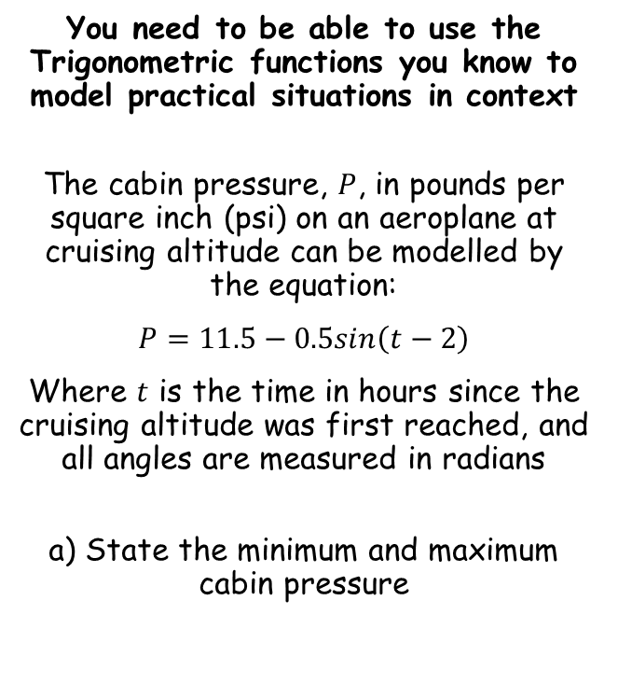






Trigonometry and Modelling
$$sin\left(α+β\right)=sinαcosβ+cosαsinβ$$
$$cos\left(α+β\right)=cosαcosβ−sinαsinβ$$
$$tan\left(A+B\right)=\frac{tanA+tanB}{1−tanAtanB}$$
$$sin\left(α−β\right)=sinαcosβ−cosαsinβ$$
$$cos\left(α−β\right)=cosαcosβ+sinαsinβ$$
$$tan\left(A−B\right)=\frac{tanA−tanB}{1+tanAtanB}$$
You need to be able to use the Trigonometric functions you know to model practical situations in context
The cabin pressure, $P$, in pounds per square inch (psi) on an aeroplane at cruising altitude can be modelled by the equation:
$P=11.5−0.5sin\left(t−2\right)$
Where $t$ is the time in hours since the cruising altitude was first reached, and all angles are measured in radians
a) State the minimum and maximum cabin pressure
The minimum value would be when we subtract as much as possible from 11.5
$$P=11.5−0.5sin\left(t−2\right)$$
The highest value of the $sine$ term is 1
$$P=11.5−0.5(1\text{)}$$
$$Min=11psi$$
Calculate
$$Max=12psi$$
$$P=11 psi$$
The maximum value would be when we add as much as possible to 11.5
$$P=11.5−0.5sin\left(t−2\right)$$
We need this term to be negative, and as low as possible – the value needs to be -1
$$P=11.5−0.5(−1\text{)}$$
Calculate
$$P=12 psi$$
7G

Slide 58



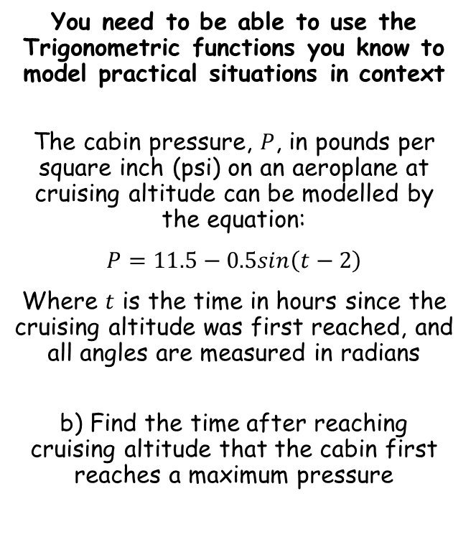




Trigonometry and Modelling
$$sin\left(α+β\right)=sinαcosβ+cosαsinβ$$
$$cos\left(α+β\right)=cosαcosβ−sinαsinβ$$
$$tan\left(A+B\right)=\frac{tanA+tanB}{1−tanAtanB}$$
$$sin\left(α−β\right)=sinαcosβ−cosαsinβ$$
$$cos\left(α−β\right)=cosαcosβ+sinαsinβ$$
$$tan\left(A−B\right)=\frac{tanA−tanB}{1+tanAtanB}$$
You need to be able to use the Trigonometric functions you know to model practical situations in context
The cabin pressure, $P$, in pounds per square inch (psi) on an aeroplane at cruising altitude can be modelled by the equation:
$P=11.5−0.5sin\left(t−2\right)$
Where $t$ is the time in hours since the cruising altitude was first reached, and all angles are measured in radians
b) Find the time after reaching cruising altitude that the cabin first reaches a maximum pressure
$$P=11.5−0.5sin\left(t−2\right)$$
We want the pressure to be at its maximum value
$$12=11.5−0.5sin\left(t−2\right)$$
Subtract 11.5
$$0.5=−0.5sin\left(t−2\right)$$
Divide by -0.5
$$Min=11psi$$
$$−1=sin\left(t−2\right)$$
$$Max=12psi$$
$$−\frac{1}{2}π=t−2$$
Inverse sine
Add 2
$$2−\frac{1}{2}π=t$$
Calculate
$$0.43=t$$
So the time would be 26 minutes (multiply the time in hours by 60)
→ Note that you might need to find more than one possible solution to the trig equation, depending on what you are asked!
7G

Slide 59


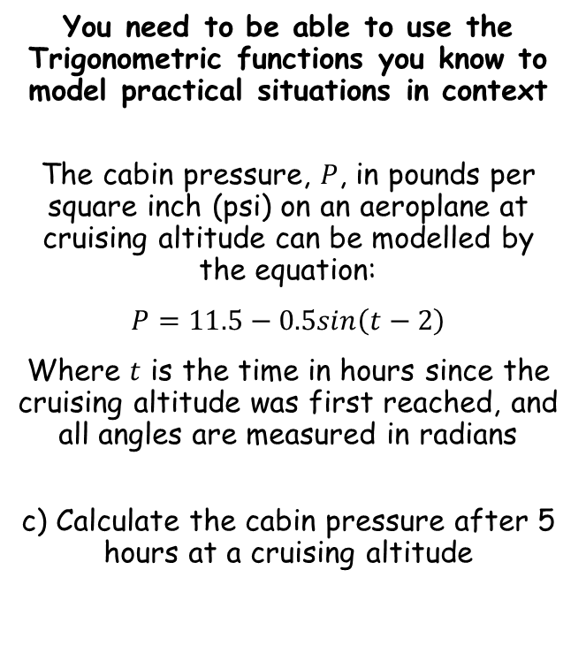


Trigonometry and Modelling
$$sin\left(α+β\right)=sinαcosβ+cosαsinβ$$
$$cos\left(α+β\right)=cosαcosβ−sinαsinβ$$
$$tan\left(A+B\right)=\frac{tanA+tanB}{1−tanAtanB}$$
$$sin\left(α−β\right)=sinαcosβ−cosαsinβ$$
$$cos\left(α−β\right)=cosαcosβ+sinαsinβ$$
$$tan\left(A−B\right)=\frac{tanA−tanB}{1+tanAtanB}$$
You need to be able to use the Trigonometric functions you know to model practical situations in context
The cabin pressure, $P$, in pounds per square inch (psi) on an aeroplane at cruising altitude can be modelled by the equation:
$P=11.5−0.5sin\left(t−2\right)$
Where $t$ is the time in hours since the cruising altitude was first reached, and all angles are measured in radians
c) Calculate the cabin pressure after 5 hours at a cruising altitude
$$P=11.5−0.5sin\left(t−2\right)$$
Sub in $t=5$
$$P=11.5−0.5sin\left(5−2\right)$$
Calculate
$$P=11.43psi$$
7G

Slide 60


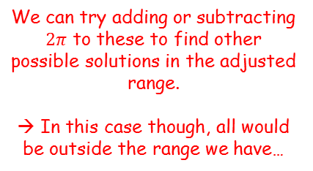



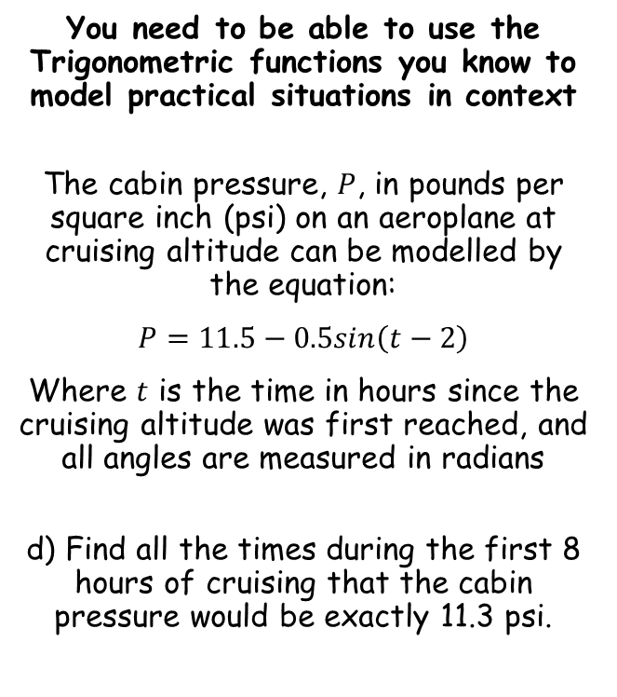









Trigonometry and Modelling
$$sin\left(α+β\right)=sinαcosβ+cosαsinβ$$
$$cos\left(α+β\right)=cosαcosβ−sinαsinβ$$
$$tan\left(A+B\right)=\frac{tanA+tanB}{1−tanAtanB}$$
$$sin\left(α−β\right)=sinαcosβ−cosαsinβ$$
$$cos\left(α−β\right)=cosαcosβ+sinαsinβ$$
$$tan\left(A−B\right)=\frac{tanA−tanB}{1+tanAtanB}$$
You need to be able to use the Trigonometric functions you know to model practical situations in context
The cabin pressure, $P$, in pounds per square inch (psi) on an aeroplane at cruising altitude can be modelled by the equation:
$P=11.5−0.5sin\left(t−2\right)$
Where $t$ is the time in hours since the cruising altitude was first reached, and all angles are measured in radians
d) Find all the times during the first 8 hours of cruising that the cabin pressure would be exactly 11.3 psi.
$$P=11.5−0.5sin\left(t−2\right)$$
We want to know when the psi will be 11.3
$$11.3=11.5−0.5sin\left(t−2\right)$$
Subtract 11.5
$$−0.2=−0.5sin\left(t−2\right)$$
Divide by -0.5
$$0.4=sin\left(t−2\right)$$
Inverse sine
$$0.41=t−2$$
1
0.4
0.41
^{π}/₂
2.73
$$y=sint$$
-1
π
^{3π}/₂
2π
$$t−2=0.41$$
$$, 2.73$$
We can try adding or subtracting $2π$ to these to find other possible solutions in the adjusted range.
→ In this case though, all would be outside the range we have…
$$t=2.41$$
$$, 4.73$$
Ensure you know the range you are working with first!
$$0≤t≤8$$
$$t=2h 25min$$
Calculate
$$t=4h 44min$$
$$−2≤t−2≤6$$
7G

